Slide 1
Lab Introduction
CSE 211 – Digital Design

Slide 2
R.A. Erdinç Türk
How to contact me?
Email: erdincturk@akdeniz.edu.tr
MS Teams

Slide 3
Lab Structure
Weekly Labs: 8 total sessions (1 lab per week)
Duration: Each lab will last approximately 1.5 hours
Location: Elektrik – Elektronik Ölçme ve Devre Laboratuvarı

Slide 4
Lab Structure
Lab | Lab Name | Related Book Chapter
Lab 01 | Digital Logic Gates | Chapter 02 - Boolean Algebra and Logic Gates
Lab 02 | Simplifications | Chapter 03 - Gate Level Minimization
Lab 03 | Adders and Subtractors | Chapter 04 - Combinational Logic
Lab 04 | Encoders and Decoders | Chapter 04 - Combinational Logic
Lab 05 | Multiplexers | Chapter 04 - Combinational Logic
Lab 06 | Flip Flops | Chapter 05 - Synchronous Sequential Logic
Lab 07 | Ripple Counters | Chapter 06 - Registers and Counters
Lab 08 | Synchronous Counters | Chapter 06 - Registers and Counters

Slide 5


Tools and Resources
Tools:
Logisim: http://www.cburch.com/logisim/
or
Proteus Design Suite: https://www.labcenter.com/
Textbook Reference: Digital Design by M. Morris Mano

Slide 6
Lab Sections
Total Sections: 2 sections available for the lab.
Lab starts at 13:30 for Section 1 students.
Lab starts at 15:30 for Section 2 students.
Student Capacity: Approximately 44 students per section.
Group Size: Groups will consist of 4 students each

Slide 7
Lab Rules
Arrive on time; late students will not be accepted.
Handle lab equipment with care and report any damage immediately.
Work collaboratively within your assigned group; ensure all members participate.
Seek help or clarification when needed; encourage discussion within your group.
Clean your workspace and return all equipment to its proper place after the session.
Food and drinks are not allowed in the lab.

Slide 8
Lab Workflow
Pre-Lab Preparation
Read Pre-Readings: Complete any assigned readings before the lab session.
Pre-Report Submission
Fill Out Pre-Report: Complete the lab pre-report if assigned (individually).
Submit on Teams: Return the pre-report on Teams prior to the lab (individually).
During the Lab
Conduct Experiments: Successfully carry out the assigned experiments.
Collaborate: Work effectively within your group and assist each other.
Post-Lab Assignment
Return Assignment: Submit any assignments related to the lab after completion.

Slide 9
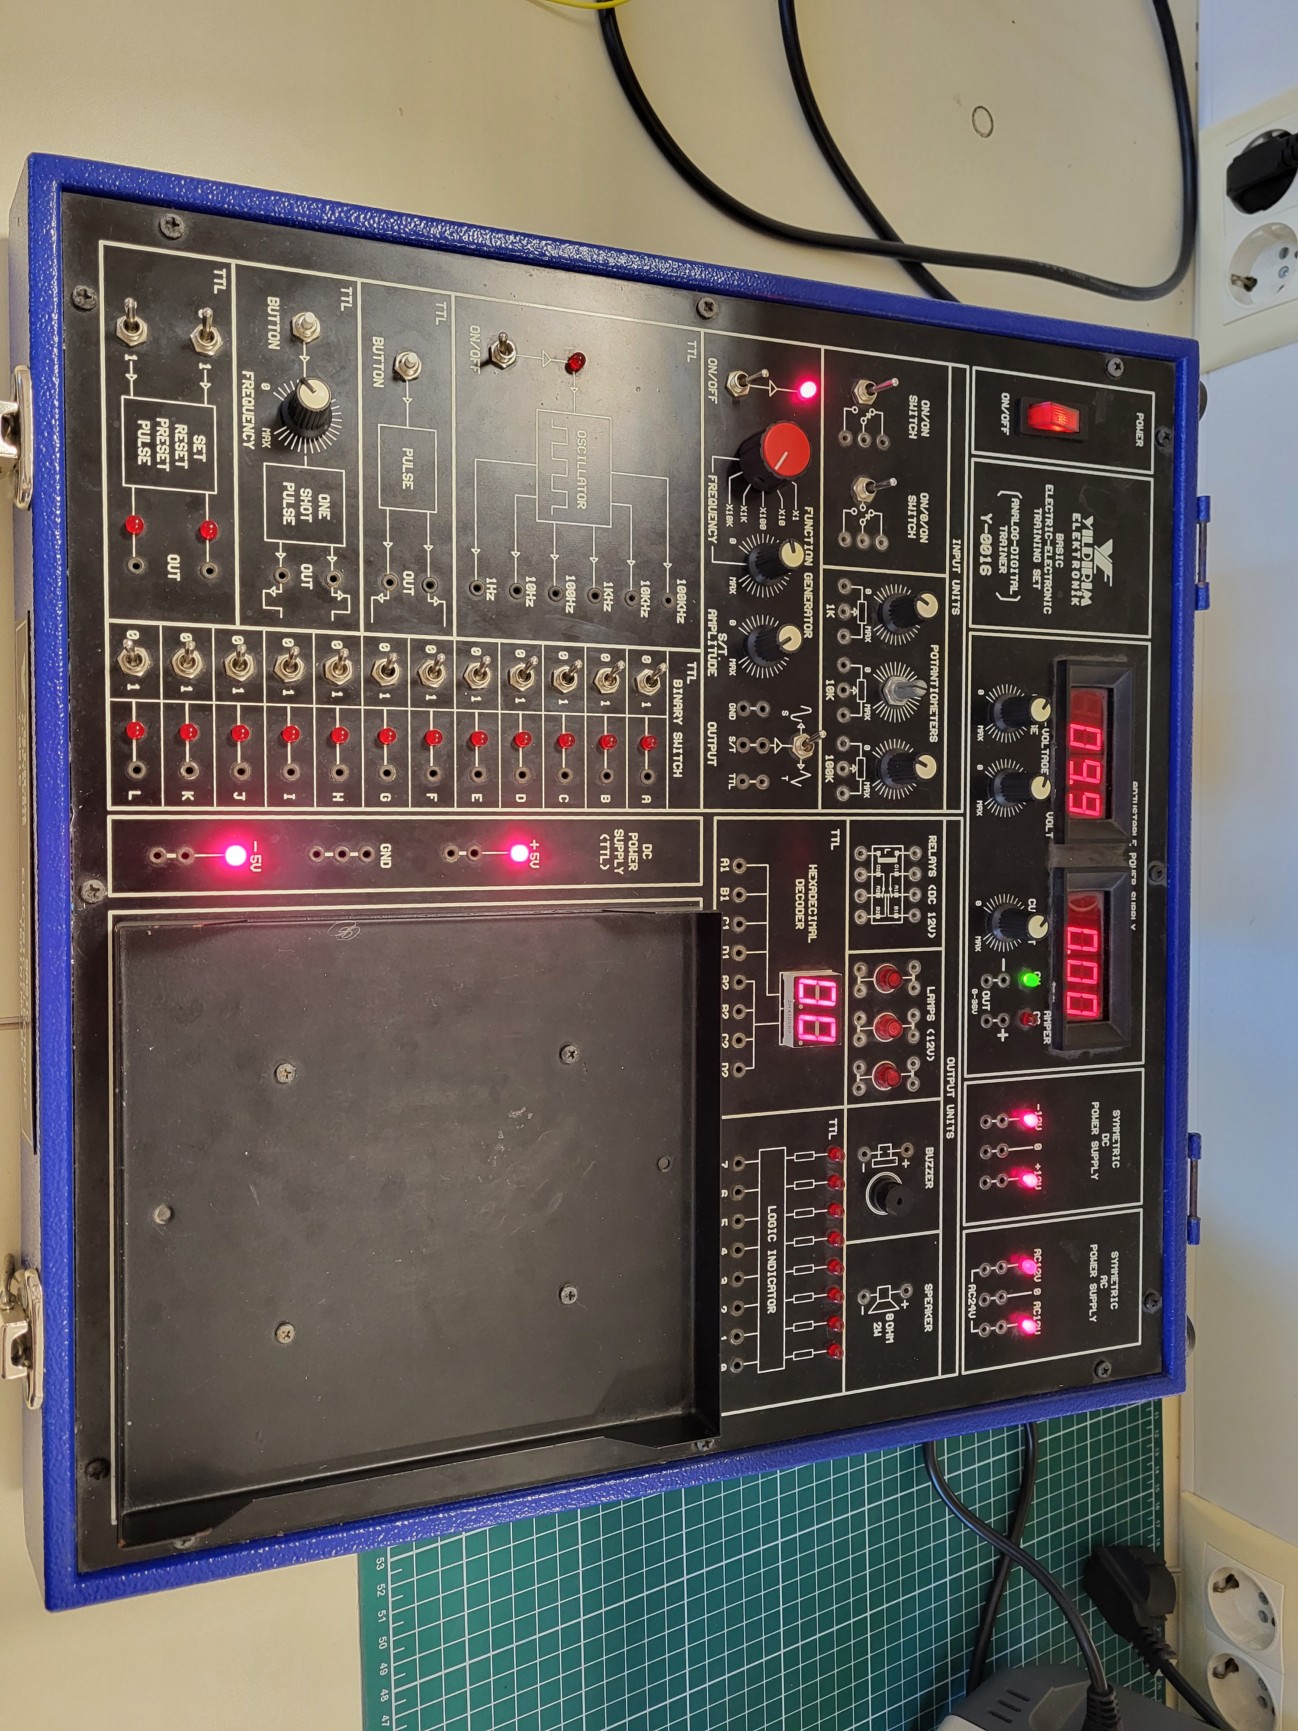
What you need to know?
Basic Electricity Electronics Training Set Manual
The only part we will use during the labs
Breadboard

Slide 10
What you need to know?
How to use a breadboard
https://learn.sparkfun.com/tutorials/how-to-use-a-breadboard/all

